Slide 1
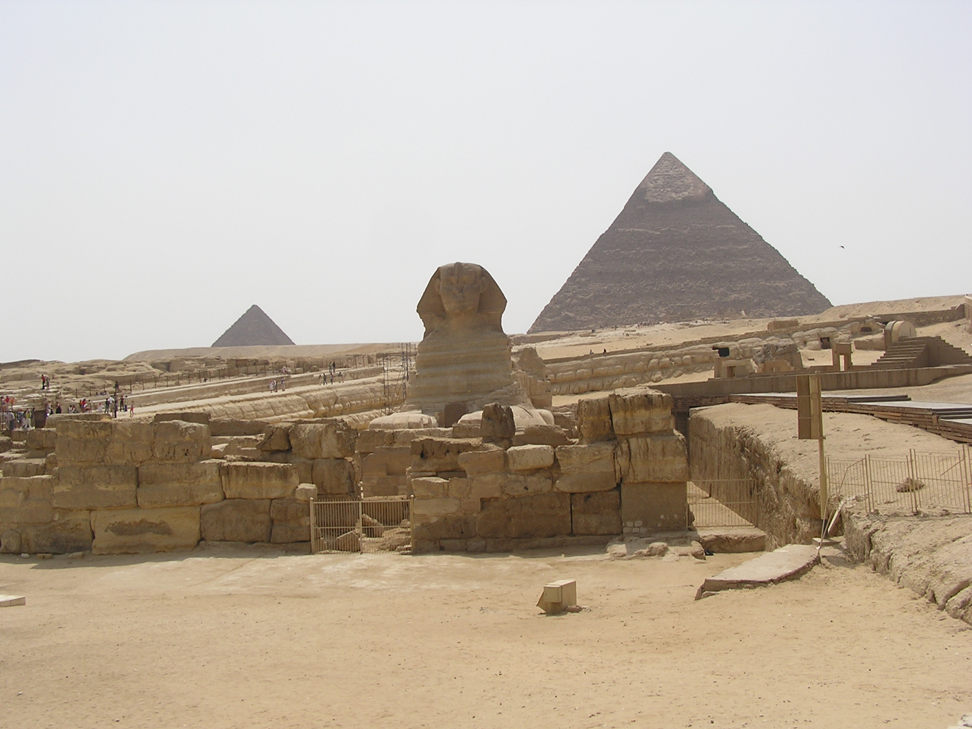
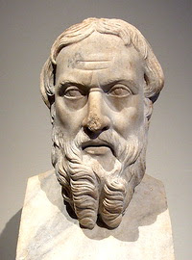
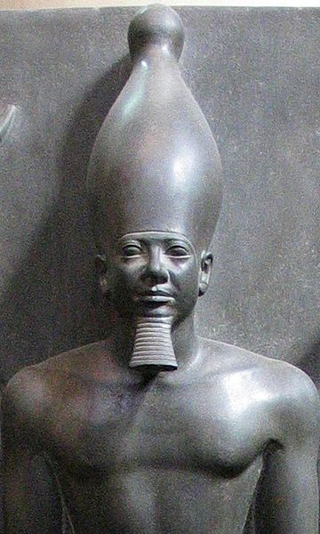
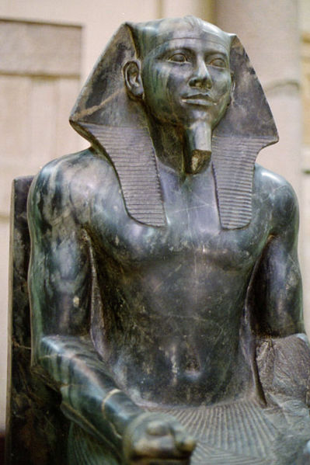
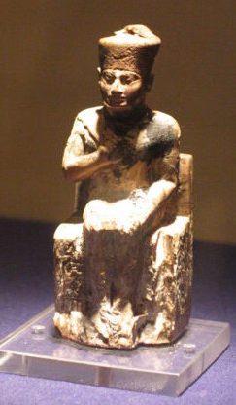
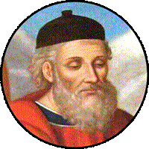
Schemes of Egyptian History in the Works of Herodotus and Diodorus Siculus: A History-Writing of Renaissance?
Ivan Ladynin

Slide 2
Ladynin I.A. The ‘Crisis of the Pyramid Builders’ in Herodotus’ Book II and the Epochs of Egyptian History // Deformations and Crises of the Ancient Civil Communities / Ed. P.D. Rhodes. Stuttgart: Steiner, 2015. P. 15—26.

Slide 3
Boundaries between the big epochs of Egyptian history in the narration of Herodotus
Hdt. 100.1: After him (Min) came three hundred and thirty kings, whose names the priests recited from a papyrus roll. In all these many generations there were eighteen Ethiopian kings, and one queen, native to the country; the rest were all Egyptian men... 101.1: But of the other kings they related no achievement or act of great note, except of Moeris, the last of them. 142.1: Thus far (to the reign of “the priest of Hephaestus whose name was Sethos”: 141) went the record given by the Egyptians and their priests; and they showed me that the time from the first king to that priest of Hephaestus, who was the last, covered three hundred and forty-one generations, and that in this time this also had been the number of their kings, and of their high priests.
NB: “For all that, a survey of such chronological tables as that of Gardiner indicates that a figure in the 350s would be perfectly compatible with available sources, and it is most intriguing that Manetho yields 323 if we simply use the volume totals given for the first two books of his work and add the dynasty totals from the Twentieth Dynasty down to Sethos/Sebichos” (Lloyd 1988: 34).

Slide 4
Diod. I. 60. 1: But Amasis, who became king many generations later, ruled the masses of the people with great harshness; many he punished unjustly, great numbers he deprived of their possessions, and towards all his conduct was without exception contemptuous and arrogant. 2. Now for a time his victims bore up under this, being unable in any way to protect themselves against those of greater power; but when Actisanes, the king of the Ethiopians, led an army against Amasis, their hatred seized the opportunity and most of the Egyptians revolted. 3. As a consequence, since he was easily overcome, Egypt fell under the rule of the Ethiopians. But Actisanes carried his good fortune as a man should and conducted himself in a kindly manner towards his subjects… 61.1: After the death of this king the Egyptians regained the control of their government and placed on the throne a native king, Mendes, whom some call Marrus…

Slide 5
Sesonchosis in the scholia to Apollonius Rhodius, IV
codex Laurentianus XXXII.9 (10th century) [Keil 1854, 496—497] |  | codex Parisinus 2727 (15th century) [Schaefer 1813, 288—289]
272—274: ἔ ν θ ε ν δ ή τ ι ν α· Σεσόγχωσις Αἰγύπτου πάσης βασιλεὺς μετὰ ῏Ωρον τὸν ῎Ισιδος καὶ ᾿Οσίριδος παῖδα τὴν μὲν Ἀσίαν ὁρμήσας πᾶσαν κατεστρέψατο, ὁμοίως καὶ τὰ πλεῖστα τῆς Εὐρώπης. ἀκριβέστερον δὲ ἔστι τὰ περὶ αὐτοῦ παρὰ Ἡροδότῳ. Θεόπομπος δὲ ἐν τρίτῳ Σέσωστριν αὐτὸν καλεῖ. Δικαίαρχος δὲ ἐν α′ καὶ νόμους αὐτὸν θεῖναι λέγει, ὥστε μηδένα καταλιπεῖν τὴν πατρῴαν τέχνην· τοῦτο γὰρ ὑπολαμβάνειν ἀρχὴν εἶναι πλεονεξίας. καὶ πρῶτόν φησιν αὐτὸν εὑρηκέναι ἵππων ἄνθρωπον ἐπιβαίνειν. οἱ δὲ ταῦτα τὸν ῏Ωρον, οὐ τὸν Σεσόγχωσιν. | From here someone: Sesonchosis, the king of entire Egypt after Orus, the son of Isis and Osiris, attacking Asia subdued (it) all as well as the major part of Europe. It is more precise about him at Herodotus. And Theopompus in third (book) calls him Sesostris. Dicaearchus in the first (book) says that he established laws that no one should abandon his fathers trade. For he assumed that this was the origin of greed. And he says that he was the first man to discover mounting horses. Others (say it was) Orus, and not Sesonchosis (frg. 58 Fortenbaugh-Schütrupf). | 272—276: Τὸ δὲ ἔ ν θ ε ν δ ή τ ι ν α περὶ τοῦ Σεσωγχώσιδος λέγει. Οὗτος γὰρ Αἰγύπτου πάσης βασιλεύσας μετὰ ῏Ωρον τὸν ᾿Οσίριδος καὶ ῎Ισιδος παῖδα, τὴν τε Ἀσίαν ὁρμήσας πᾶσαν κατεστρέψατο, καὶ μέρη πλεῖστα τῆς Εὐρώπης. ἀκριβέστερον δὲ τὰ περὶ αὐτοῦ παρὰ Ἡρόδοτος διηγεῖται…Θεόπομπος δὲ ἐν τῷ γ′ Σέσωστριν αὐτὸν καλεῖ. καὶ νόμους δὲ λέγει Δικαίαρχος αὐτὸν τεθεικέναι, μηδένα ἐκλείπειν τὴν πατρώαν τέχνην· τοῦτο γὰρ ᾤετο ἀρχὴν εἶναι πλεονεξίας. καὶ πρῶτον δὲ εὑρηκέναι ἵππoν ἐπιβαίνειν ἄνθρωπον. ἄλλοι δὲ ταῦτα εἰς ῏Ωρον ἀναϕέροῦσι. καὶ τοῦτο δέ ϕησι Δικαίαρχος ἐν β′ Ἑλληνικοῦ βίου Σεσώστριδι μεμεληκέναι | The words from here someone (Apollonius) says about Sesonchosis. He, reigning over the entire Egypt after Orus, the son of Isis and Osiris, attacking Asia subdued (it) all and the major part of Europe. Herodotus narrates about him more precisely… And Theopompus in third (book) calls him Sesostris. And Dicaearchus says that he established laws that no one abandon his fathers trade; for he considered that the origin of greed. And that he was the first man to discover mounting horses. The other bring that back to Orus. And Dicaearchus says in the second (book) of Hellenic Life that this was the care of Sesostris.

Slide 6
Sesonchosis in Manetho’s Aegyptiaka (ed. W.G. Waddell)
Dynasty XII, hist. Senwosret I:
frgg. 34.1, 35.1: Σεσόγχοσις
frg. 36.1: Sesonchosis
Dynasty XII, hist. Senwosret III:
frgg. 34.3, 35.3: Σέσωστρις
frg. 36.3: Sesostris
Dynasty XXII, hist. Shoshenq I:
frg. 60.1 (Africanus): Σεσώγχις
frg. 61a.1 (Eusebius/Synkellus): Σεσώγχωσις
frg. 61b.1 (Eusebius/Armenian version): Sesonchosis

Slide 7
Diod. I. 54.1: In preparation for this undertaking he first of all confirmed the goodwill of all the Egyptians towards himself, feeling it to be necessary, if he were to bring his plan to a successful end, that his soldiers on the campaign should be ready to die for their leaders, and that those left behind in their native lands should not rise in revolt. 2. He therefore showed kindnesses to everyone by all means at his disposal, winning over some by presents of money, others by gifts of land, and others by remission of penalties, and the entire people he attached to himself by his friendly intercourse and kindly ways; for he set free unharmed everyone who was held for some crime against the king and cancelled the obligations of those who were in prison for debt, there being a great multitude in the gaols. 3. And dividing the entire land into thirty-six parts which the Egyptians call nomes, he set over each a nomarch, who should superintend the collection of the royal revenues and administer all the affairs of his division. 4. He then chose out the strongest of the men and formed an army worthy of the greatness of his undertaking; for he enlisted six hundred thousand foot-soldiers, twenty-four thousand cavalry, and twenty-seven thousand war chariots. 5. In command of the several divisions of his troops he set his companions, who were by this time inured to warfare, had striven for a reputation for valour from their youth, and cherished with a brotherly love both their king and one another, the number of them being over seventeen hundred. 6. And upon all these commanders he bestowed allotments of the best land in Egypt, in order that, enjoying sufficient income and lacking nothing, they might sedulously practise the art of war.
Cf.: Meyer Ed. König Sesonchosis als Begründer der Kriegerkaste bei Diodor // ZÄS. 1913. Bd. 51. S. 136—137.
Hdt. II. 109.1: For this reason Egypt was intersected. This king (Sesostris) also (they said) divided the country among all the Egyptians by giving each an equal parcel of land, and made this his source of revenue, assessing the payment of a yearly tax; 168.1: The warriors were the only Egyptians, except the priests, who had special privileges: for each of them an untaxed plot of twelve acres was set apart. This acre is a square of a hundred Egyptian cubits each way, the Egyptian cubit being equal to the Samian.

Slide 8
Hdt. I.136.1. After Mycerinus, the priests said, Asukhis became king of Egypt. He built the eastern outer court of Hephaestus' temple; this is by far the finest and grandest of all the courts, for while all have carved figures and innumerable felicities of architecture, this court has far more than any. 2. As not much money was in circulation during this king's reign, they told me, a law was made for the Egyptians allowing a man to borrow on the security of his father's corpse; and the law also provided that the lender become master of the entire burial-vault of the borrower, and that the penalty for one giving this security, should he fail to repay the loan, was that he was not to be buried at his death either in that tomb of his fathers or in any other, nor was he to bury any relative of his there.
Diod. I.94.3: A second lawgiver, according to the Egyptians, was Sasychis, a man of unusual understanding. He made sundry additions to the existing laws and, in particular, laid down with the greatest precision the rites to be used in honouring the gods, and he was the inventor of geometry and taught his countrymen both to speculate about the stars and to observe them.
Diod. I. 45.1 After the gods the first king of Egypt, according to the priests, was Menas, who taught the people to worship gods and offer sacrifices, and also to supply themselves with tables and couches and to use costly bedding, and, in a word, introduced luxury and an extravagant manner of life. 2. For this reason when, many generations later, Tnephachthus, the father of Bocchoris the wise, was king and, while on a campaign in Arabia, ran short of supplies because the country was desert and rough, we are told that he was obliged to go without food for one day and then to live on quite simple fare at the home of some ordinary folk in private station, and that he, enjoying p161 the experience exceedingly, denounced luxury and pronounced a curse on the king who had first taught the people their extravagant way of living; and so deeply did he take to heart the change which had taken place in the people's habits of eating, drinking, and sleeping, that he inscribed his curse in hieroglyphs on the temple of Zeus in Thebes; and this, in fact, appears to be the chief reason why the fame of Menas and his honours did not persist into later ages.

Slide 9
Hdt.: Acc. Ἄσυχιν
Diod.: Acc. Σάσυχιν
Tefnakhte: H. + N. siA-Xt “Wise, knowing with his belly”
Cf. Zoser: H. ntry-Xt, Sekhemkhet: H. sxm-Xt; Menkaure: H. kA-Xt; Shepseskaf: H. Sps-Xt (Ritner, Fs. Lesko, 2008: 308)

Slide 10
Diod. I. 65.1. After the kings mentioned above Bocchoris succeeded to the throne, a man who was altogether contemptible in personal appearance but in sagacity far surpassed all former kings. 2. Much later Egypt was ruled by Sabaco, who was by birth an Ethiopian and yet in piety and uprightness far surpassed his predecessors.
Manetho:
Ael. De nat. anim. XI. 11: [Bocchoris causing a bull to fight the sacred bull Mnevis].
Plut. De vit. pud. 3: It is recorded of Bocchoris, king of Egypt, a man of a very cruel nature, that the goddess Isis sent a kind of a serpent (called aspis), which winding itself about his head cast a shadow over him from above, and was a means to him of determining causes according to equity.
Dynasty XXIV Frg. 64 (Sync./Afr.): Bochchôris of Saïs, for 6 years: in his reign a lamb spoke . . . 990 years. Frg. 65(a) (Sync./Eus.): Bochchôris of Saïs, for 44 years: in his reign a lamb spoke. Total, 44 years. Frg. 65(b) (Arm. Eus.): Bocchoris of Saïs, for 44 years: in his reign a lamb spoke. | Dynasty XXV Frg. 66 (Sync./Afr.): 1. Sabacôn, who, taking Bochchôris captive, burned him alive, and reigned for 8 years. Frg. 67(a) (Sync./Eus.): 1. Sabacôn, who, taking Bochchôris captive, burned him alive, and reigned for 12 years. Frg. 67(b) (Arm. Eus.): 1. Sabacon, who, taking Bocchoris captive, burned him alive, and reigned for 12 years.

Slide 11
“Oracle of Lamb”, 2-1 (?) centuries B.C.: [predictions of the hardships of Egypt under foreign rule set in the time of Bocchoris]
Lysimachus of Alexandria, FGrHist. 621. F. 1:
Ios. C. Ap. I. 304 ff.: I shall now add to these accounts about Manetho and Cheremon somewhat about Lysimachus, who hath taken the same topic of falsehood with those forementioned, but hath gone far beyond them in the incredible nature of his forgeries; which plainly demonstrates that he contrived them out of his virulent hatred of our nation. His words are these: "The people of the Jews being leprous and scabby, and subject to certain other kinds of distempers, in the days of Bocchoris, king of Egypt, they fled to the temples, and got their food there by begging: and as the numbers were very great that were fallen under these diseases, there arose a scarcity in Egypt. Hereupon Bocchoris, the king of Egypt, sent some to consult the oracle of [Jupiter] Hammon about his scarcity. The god's answer was this, that he must purge his temples of impure and impious men, by expelling them out of those temples into desert places; but as to the scabby and leprous people, he must drown them, and purge his temples, the sun having an indignation at these men being suffered to live; and by this means the land will bring forth its fruits. Upon Bocchoris's having received these oracles, he called for their priests, and the attendants upon their altars, and ordered them to make a collection of the impure people, and to deliver them to the soldiers, to carry them away into the desert; but to take the leprous people, and wrap them in sheets of lead, and let them down into the sea. Hereupon the scabby and leprous people were drowned, and the rest were gotten together, and sent into desert places, in order to be exposed to destruction.
Tac. V. 3: Most writers, however, agree in stating that once a disease, which horribly disfigured the body, broke out over Egypt; that king Bocchoris, seeking a remedy, consulted the oracle of Hammon, and was bidden to cleanse his realm, and to convey into some foreign land this race detested by the gods. The people, who had been collected after diligent search, finding themselves left in a desert, sat for the most part in a stupor of grief...

